Slide 1
Self-Aware Networks
A Lecture by Mehmet Ali Kumral

Slide 2
Introduction
The term "self-aware network," or SAN, refers to a system made up of nodes that may join and exit the network on their own and find paths when communication is required.
The nodes in a SAN should be able to detect the state of other nodes, links, and paths, as well as the volume of traffic and congestion, in order to update their own relevant data about the paths they must utilize based on requirements unique to their own requirements.
Then, rather than having a common criterion (such as the shortest path) for all connections, each connection may employ paths that optimize the connection's particular QoS criteria.

Slide 3
These requirements might include user QoS requirements, performance, reliability, security, defense against attacks, and power utilization. A SAN can be a peer-to-peer system, a wireless network, or both.
A wireless ad hoc network is a real-world illustration of a SAN that reacts to changing conditions on wireless links and node mobility over time. (such as noise and physical obstructions).
Self-aware capabilities are also advantageous for networks that must operate autonomously and remotely, such as sensor networks.

Slide 4
What is Self-Awareness
Common phrases like "self-awareness" can provoke various responses among ordinary people as well as among scientists and engineers from various professions. We all struggle with such concepts and may not agree on what these terms genuinely mean, and we may have different interpretations.
So, before discussing how these can be integrated in the context of computer networks, we first quickly cover some relevant characteristics of self-awareness.

Slide 5
The self ”depends on consciousness, not on substance" said philosopher John Locke. Thus, by being conscious of our past, present, and future thoughts as well as by remembering and planning our actions, we can define our "self."
Any notion must be placed in opposition to another concept; hence the "self" must be related to or distinct from the "other”.
Along with our current sensory inputs, the notion of self also includes an integrated perspective of our sensory inputs from the past over time. The ability to remember one's own past should be a component of self-awareness.

Slide 6
Additionally, sensing should also include ”condition monitoring” to determine things like "are we in good health, do we feel good, and are we performing our various tasks as expected? “
Self-awareness enables a person to choose or direct not just his actions but also his thinking, for example, by deciding to focus on a past experience or a future goal rather than ruminating over ideas generated by current external stimuli.
When we focus on ourselves, we can also evaluate or critique ourselves by comparing our present and past actions to our own standards and to the actions of other entities outside of ourselves.

Slide 7
The idea of being aware of our placement in various spaces is also brought about by this concept. These spaces may include the physical places where we observe, eat, work, move, etc. as well as those that represent our actions, values, successes, and various other things.
Different spatial dimensions can describe the attributes that we are interested in; the locations in attribute space are different states that we may perceive we (or others) are in, while the distances can represent the time and effort, or value, of moving from one set of values of the attributes to another.

Slide 8
The sensory system is therefore linked to ideas of self and position.
In much simpler organisms, much of the self may actually be contained in the immediate chemical or physical (heat, electromagnetic radiation, pressure) environment.
But, in complex living organisms such as mammals, self-awareness will use a neuronal system, so that the physical embodiment of self-awareness will include a network of interacting components and sub-systems.

Slide 9
Wanted Characteristics of Self-Aware Networks
We propose that a SAN should have a distributed internal representation of itself, as well as the capability to learn possible actions it could take, in the form of paths to destinations and services, and having a motor capability for forwarding streams of packets along chosen paths.

Slide 10
Performance monitoring and condition monitoring are both part of the internal representation of the past and present experience of the network which is based on sensing and measurement, with proactive sensing being one of the concurrent tasks carried out by the SAN.
Performance monitoring gives an internal assessment of how well the network is performing its function, while condition monitoring assesses the network's health.

Slide 11
More on Internal Representation
For the network to assess when its information is insufficient or outdated and then sense its environment, such as other networks and network users, or to probe itself for condition monitoring or performance evaluation, it is surely required for the internal representation to be coupled with motor control.
A SAN need to provide a distributed representation of probable future plans and activities, as well as critical analyses of previous behaviors and actions, and potential courses of action. The system should be able to find its components and behavior in physical space as well as various network-relevant virtual spaces thanks to the internal representation.

Slide 12
Security, energy use, delay, packet loss, computational overhead, and other attributes can be included in useful virtual spaces. Network nodes placed in this geography could then be identified via these different attributes: e.g. those nodes that are secure, those that function properly, those that are conservative with energy use, etc. As a result, these properties could be utilized to differentiate between various areas (nodes and links) or sub-areas of the network.
The computer network's distributed sensor system, which analyzes and monitors network behavior, and its "motor control," which passes streams of packets from node to node along paths in the network to desired destinations, should be integrated with this distributed representation.

Slide 13
A SAN must be able to recognize threats, assess them, and identify intrusions and attacks. The ability to assess threats should be combined with distributed motor responses regarding packet routing that are motivated by self-preservation and the necessity to maintain essentially normal operation even in the face of temporary or persistent attacks.

Slide 15
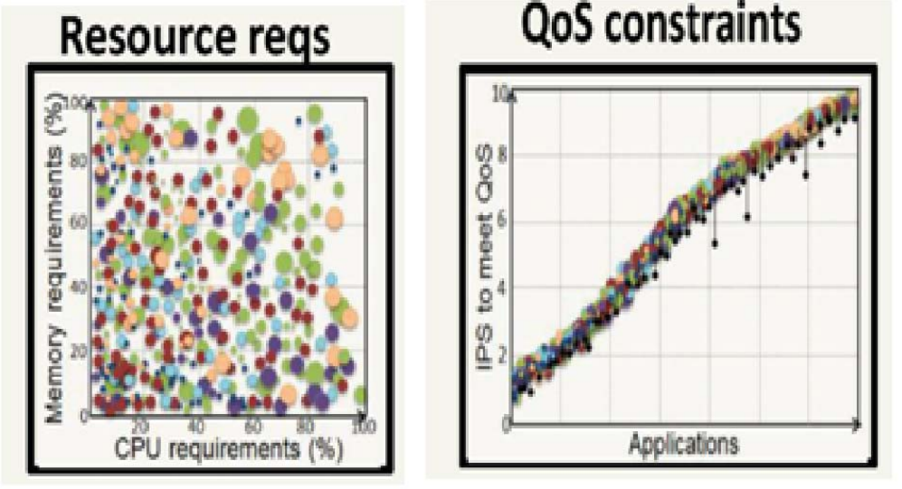

Slide 19
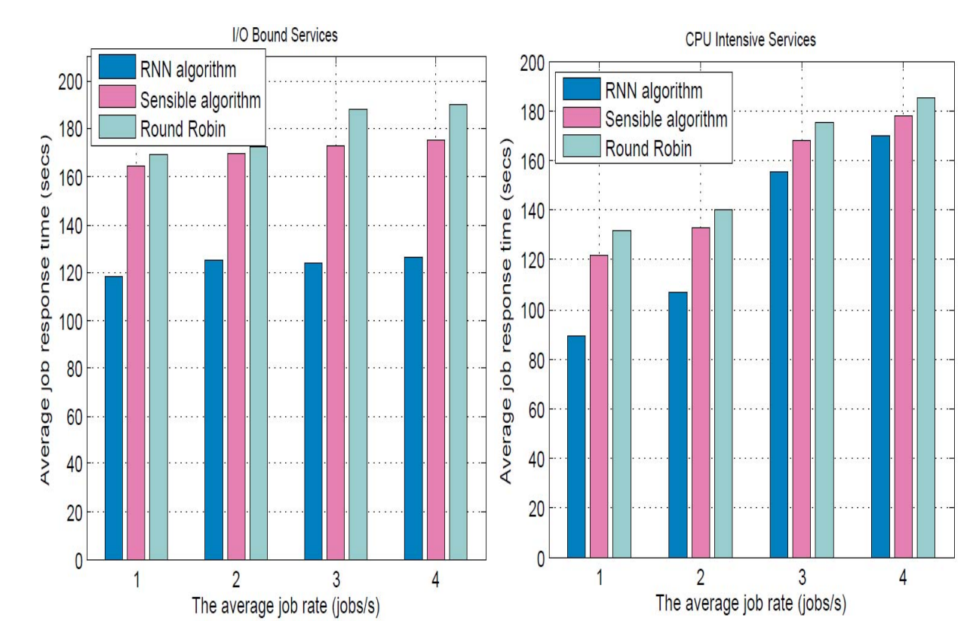

Slide 20
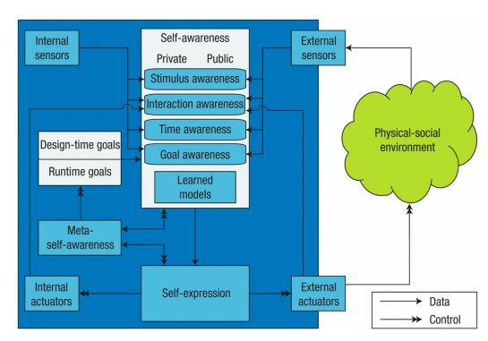

Slide 21
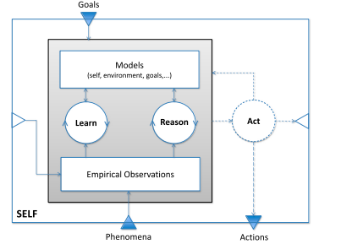

Slide 22
Development Process and Engineering of SAS’s
Self-awareness must be incorporated into a system from the start, partially because it tends to be orthogonal to the system's other functionalities but mostly because it pervades most, if not all, of the system's parts, functions, components, and aspects.
Providing blueprints for well-known and practical designs is one way to help this methodical approach. These blueprints could contain reference architectures and design patterns that direct the engineer through all stages of development.

Slide 23
Since self-awareness and autonomous decision making are not free, the designers must first determine how much flexibility and adaptability are expected or required in what parts of the system, how much those expectations require it, and how much the stakeholders are willing to pay for it.
It should be noted that this payment includes fees for resources (such as memory consumption, computational effort, and physical footprint), additional efforts (such as verification and certification), and restrictions or limitations on other system components. It is necessary to quantify these expenses and benefits in accordance with appropriate metrics.

Slide 24
The most crucial decisions should be made during concept design/engineering regarding how much self-awareness will be included in the final system, which self-awareness features are included, and which elements and functions are covered by and employed in self-awareness functions.

Slide 25
How to deal with the "blind spots," or those legacy (and other) components that have little to no self-awareness, is a particularly challenging issue. Since it is almost guaranteed that these components will exist, it follows that the SA parts must be aware of more than just themselves since they must understand the context in which the non-SA parts are present. These SA components will need to adjust to the restrictions of their non-SA partners. This implies that no SA component may be designed in isolation.

Slide 26
Since SA features may be dispersed throughout the system, the design decomposition and function allocation process must take this possibility into account. As a result, the information detection, distribution, and knowledge management functions must be carefully planned to ensure that the SA functions receive the data they need to make the decisions they will be expected to make.

Slide 27
Resource Management in SAS’s
Systems often have a limited amount of computation memory, sensor, and communication resources at their disposal. Furthermore, in order for the system to function properly and to be safe, secure, and agile, these resources must remain in balance with the requirements at hand.

Slide 28
One approach that helps to overcome this resource challenge is to off-load resource-intensive processes, such as learning or reasoning, to systems with ample resources available, such as cloud servers.
This is not always achievable, though, due to infrastructure limitations (such as not being permanently or sufficiently connected to cloud systems) as well as requirements for security and safety.

Slide 29
Approximate computation is a different strategy to deal with resource limitations. When accurate computation is not required or a certain level of imprecision is acceptable, approximate computing, which has been extensively investigated in the fields of image processing and ML, can be used.
Approximate computing solutions are intended to perform better than their precise counterparts in terms of speed, energy consumption, or silicon die size.

Slide 30
Verification of Self-Awareness
Verification is carried out at runtime and is based on anticipated behavior and a priori models of the system and environment conditions. However, as they can be expected to change at any time, a self-aware system must continuously learn these models while in operation in order to have its capabilities, resources, and behavior verified.
In scenarios that are fast developing, a system may wish to check its own capabilities in real time, but it may also need to check the capabilities of other systems in its environment that it may be interacting with.

Slide 31
The self-awareness capabilities of the system have an impact on the behavior in the system itself. The system must additionally evaluate its own level of self-awareness and link each level to a specific assurance in order to provide guarantees and preserve them during runtime. To do this, a system needs some kind of meta-self-awareness that enables it to recognize various levels of self-awareness.

Slide 32
Verifying the self-awareness capabilities of another systems becomes invaluable when the self-aware system is expected to autonomously interact and potentially collaborate.
As more and more systems in our environment depend on teamwork to complete tasks even with limited resources, verification will also become increasingly crucial. Black-Box and White-Box verification are two options that a designer may want to think about for external validation of self-awareness levels.

Slide 33
Black box testing involves testing a system with no prior knowledge of its internal workings. A tester provides an input, and observes the output generated by the system under test.
White box testing is an approach that allows testers to inspect and verify the inner workings of a software system—its code, infrastructure, and integrations with external systems.

Slide 34
Guarantees that can be Developed for a Self-Aware System

Slide 35
Fault Detection, Isolation, and Recovery.
This area of control engineering is concerned with keeping track of a system, determining when a fault has occurred, and locating the defect's nature and location.
In this context, we use it as a shorthand for a wide range of related tasks, such as system analysis for component, subsystem, mission, or enterprise-wide failures.
We identify every possible path that could result in a major failure, much like in traditional systems, and then demonstrate that these failures have been essentially prevented or at the very least mitigated, and that the proper monitoring and failure recovery procedures are in place.

Slide 36
Minimal Self-Protection
The next major category is essentially analysis and testing that show the system can properly "safe mode" itself.
Space systems possess a wide range of characteristics that are essential to placing the system into a safe state when it encounters unforeseen circumstances in space or on other planets.
Animals also exhibit a form of safety in their reflexes (for quick, instantaneous responses) and in the behavioral patterns they use to respond to unanticipated and possibly dangerous situations (such as running, hiding, displaying aggression, etc.).

Slide 37
The self-aware system could actually assist other systems in shaping the solutions for their integration and combined performance by being aware of interactions that could hurt it.
A self-aware system also must, however, identify such damaging activities during runtime given its capacity to alter its own behavior and interactions with others.

Slide 38
Minimal Acceptable Performance
The third class of guarantees will ensure that the self-aware system is able to do essential functions with that minimal acceptable performance.
This is the identification of what the system needs to sustain among its own computing resources to carry out its most crucial duties, as opposed to the question of how the system breaks and fails. This could include details on the shortest times necessary to carry out certain actions or the amount of energy needed to complete a particular task.
Using this knowledge, the system can then negotiate with other systems for potential collaboration, tradeoffs, and compromises while setting boundaries and constraints on what must be retained. This knowledge can be shared with other systems and will once more aid in limiting the kinds of tradeoffs and cooperative solutions that are feasible.

Slide 39
As this brief review has shown, the need for robust system design and analysis does not suddenly disappear when a system is self-aware; one must still carefully identify a priori the overarching aims for the system and what behaviors it must and must not engage in.
It is not true that the system has no limitations or regulations that it must abide by because not all possible operational scenarios can be anticipated in advance. Instead, it clearly defines the broad range of permitted actions and reactions.
However, when accomplished, the self-awareness of the system can in fact contribute to identifying failures and facilitate sensible responses during runtime.

Slide 40
Advantages of Self-Aware Networks
With enormously large packet networks there comes highly diverse and many applications and end users. A design that relies on a single preset idea of how it should function becomes not only unrealistic but also challenging to justify.

Slide 41
A self-aware network can be AWARE of its own resources, performance, as well as users' and the environment's ever-changing conditions. Along with the attacks and threats it faces, it can also be aware of how much energy it is utilizing.
It then uses this self-awareness and environmental knowledge as a practical tool to modify its behavior for optimum performance, adaptability, and service to users.

Slide 45
